Slide 1
Test Automation
In Agile

Slide 2
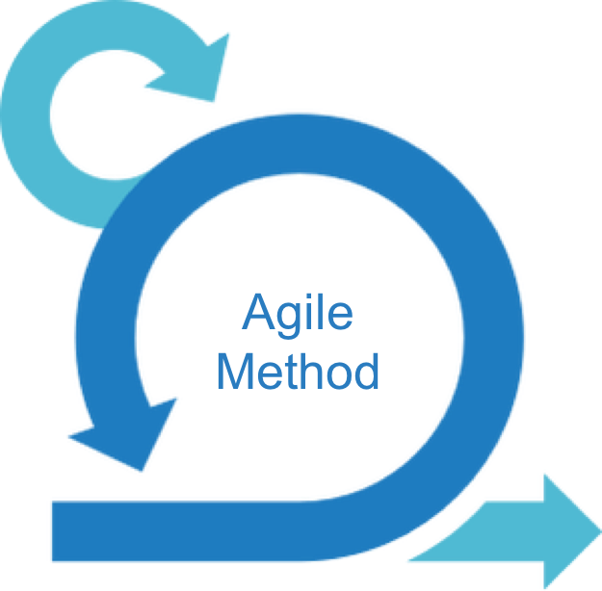



To Be Discussed
What is Test Automation
Test Automation Agile Way
Test automation In NAT
Test Automation Demo

Slide 3
What is Test Automation
Chapter 1

Slide 4
Why Test Automation
Time and Cost Saving
Increases Confidence
Increases Reliability
Quick Development and Delivery
Detects Bugs Earlier
Increases Productivity
Immediate Feedback

Slide 5
Test Automation Introduction
Structured combination of
- Various Assumptions for Testing
- Testing Concepts
- Testing Practices
Maximizes Reusability
Reduces Exposure of Non-Technical Testers to Code
Enables Test Automation using Data
Provides an Outline of overall Test Structure
Ensures Consistency of Testing
Less Maintenance

Slide 6
Test Automation Framework Types
Data Driven
Focused on separating the test scripts logic and the test data from each other
Keyword Driven
Known as table-driven testing or action word based testing
Modular
Create test scripts on module wise by breaking down the complete application under test into smaller, independent tests
Behavior Driven Development
Create a platform which allows everyone (such as Business Analysts, Developers, Testers etc,) to participate actively.
Requires increased collaboration between Development and Test Teams.

Slide 7
Test Automation Agile Way
Chapter 2

Slide 8

Plan and be prepared for Agile beforehand
Agile projects can only succeed with inherent Agile teams. QA and development teams are equally essential to the project’s success, from an original idea to the final build. Both sides should be proactive enough to collaborate with each other and the product owner continuously from the early stages while keeping up with all clients’ requirements.
Agile is meant to be a lean process that requires the team to finish all planned workload in short sprints. The automation testing plan, including the desired automation framework if the team opts to apply open-source tools, must be designed and built correctly in advance before beginning the project.

Slide 9
Know what test cases to automate
Not all test cases in Agile projects are feasible for automation. With a high volume of requirement changes, the Agile team usually comes with instant adjustments in the code base, making it fragile and unstable. Test automation tools cannot handle such fragile objectives and require costly script maintenance in the long run. Regression testing is the must-have candidate to be automated. With “fixed” features in previous sprints, automation reduces time and resources for them while ensuring their functionality against the impact of new changes.
New features that are developed in the current build should be left for manual testing. Automating them in the first place does not benefit the QA team much because they will need to frequently re-test them as new changes occur.

Slide 10
Get the Right Automation Tool
It is important to select the right test automation tool and for this, you must invest enough time in evaluating the capabilities of the tool. Ideally, before purchasing any test automation tool, you must ensure it meets certain basic criteria or features to ensure the success of the test automation program. Listed below are few ideal features that every test automation tool must have regardless of the type of testing to be performed:
The tool should be OS friendly
It should be capable of meeting end-to-end testing requirements.
The tool should be user-friendly which will determine how easily a user can get up and ready with test automation.
The tool should offer integration support with cross-functional tools like bug tracking tools, test management tools, continuous integrations, etc.
The tool you choose should be robust and provide quick results so that testers can respond to the test results quickly

Slide 11
Adopt DevOps
DevOps is a principal of merging the Development, Testing, and Operations role. One can tap the benefits of collaboration and cross-functioning from the same team, which enhances the speed and software delivery process. Since DevOps promotes shared working, development, integration and testing happen in real-time, which makes the entire agile cycle more efficient.

Slide 12
Develop Quality Test Scripts
The objective behind this is to execute smoother and correct testing, especially regression testing without any intervention from the testers. If the test scripts are of sound and stable, the testing team can complete the regression test cycle without making unnecessary changes and can also avail the benefits of performance, speed, and accuracy.

Slide 13
Keep Your Tests Small & Lean
Make sure that the test cases are small and lean. This will help in attaching unnecessary test data which add no value to the test outcomes. Keeping smaller test cases will also help in making quick changes as per regression requirements. Moreover, it reduces the maintenance of large test suites, which contain different codes, configuration, and scenarios, thereby reducing the overall load on the development environment.

Slide 14
Test Automation In NAT
Chapter 3

Slide 15
Mission Statement
Design Test Automation System
Supports Continuous Testing Model
Reliable
Supports CI/CD

Slide 16
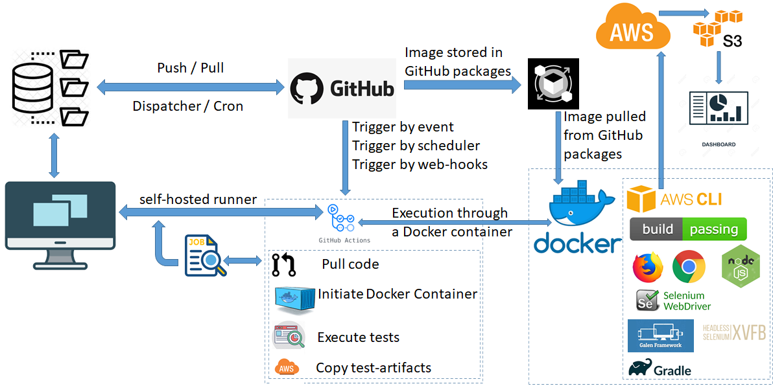
Test Automation System Architecture

Slide 17
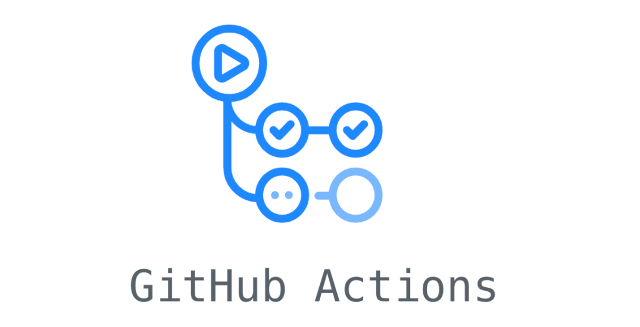











Technical Skills
Test Frameworks
Tools for Build Management and Development
Tools to Design Continuous Testing Model

Slide 18
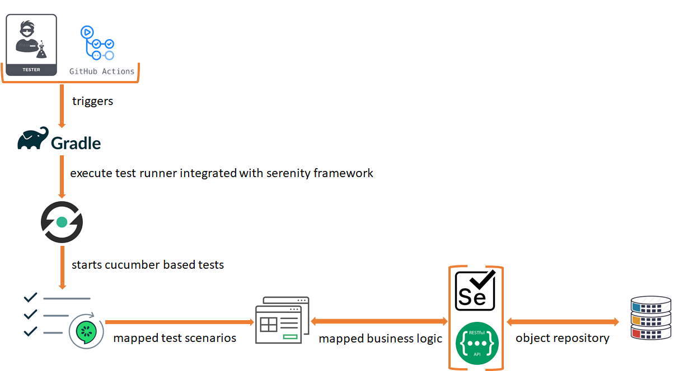
Test Automation Script Flow

Slide 19
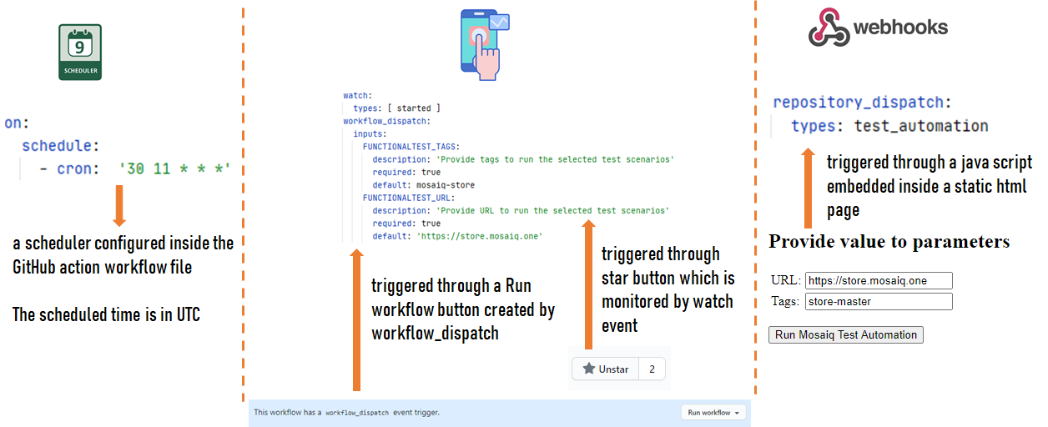
Ways To Trigger Test Automation

Slide 20
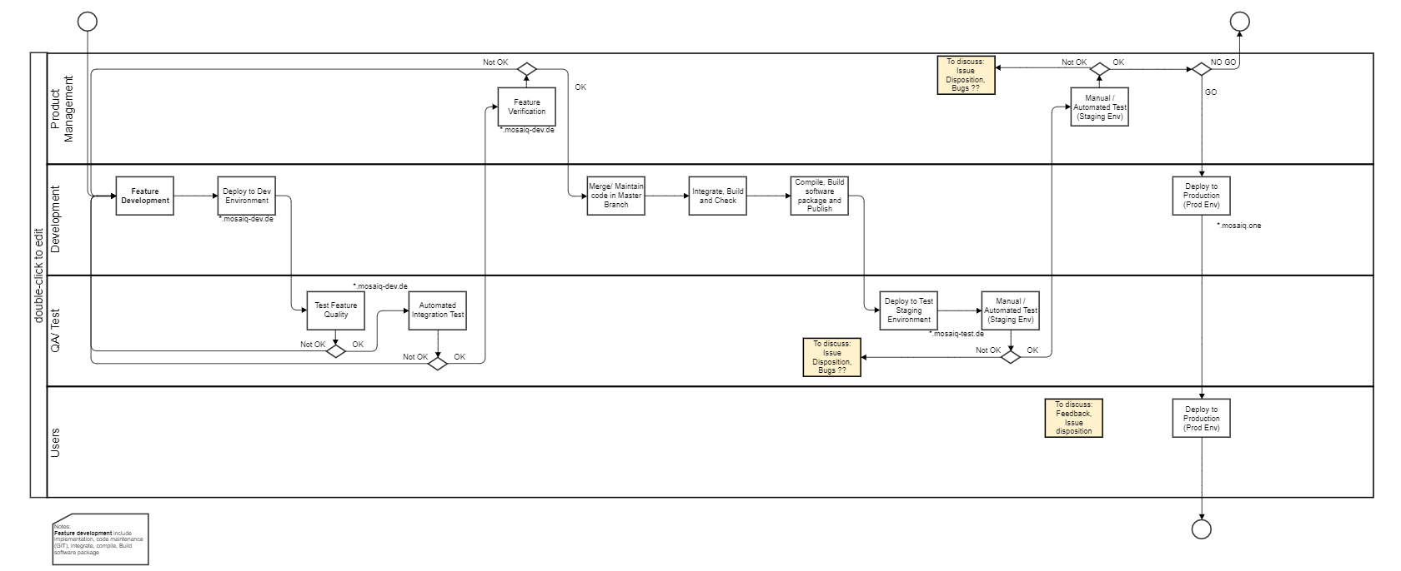
Proposed Process

Slide 21
Test Automation Demo
Chapter 4

Slide 22
Thank You

